Slide 1
Intro to Physical Computing

Slide 2
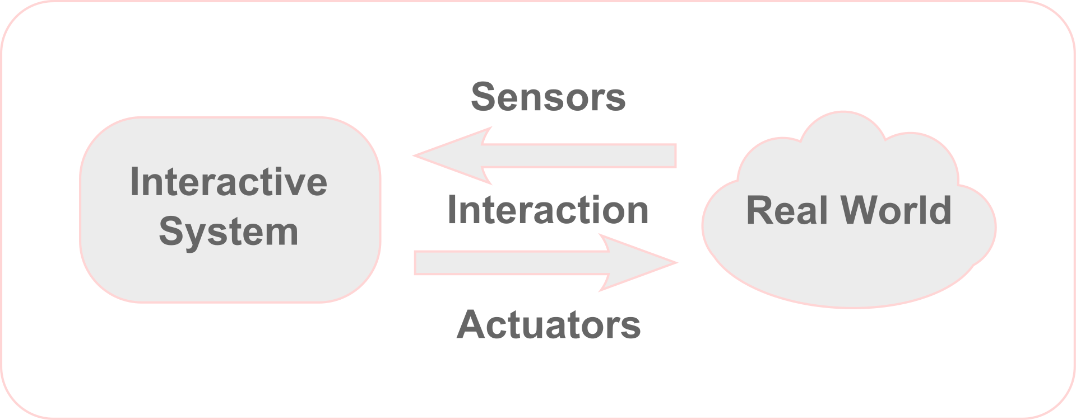
Physical Computing
means building interactive physical systems by the use of software and hardware that can sense and respond to the analog world.

Slide 3
Physical Computing Examples
Assistive tech
Drones
3D printers
Museums
Fun!!!!!

Slide 4
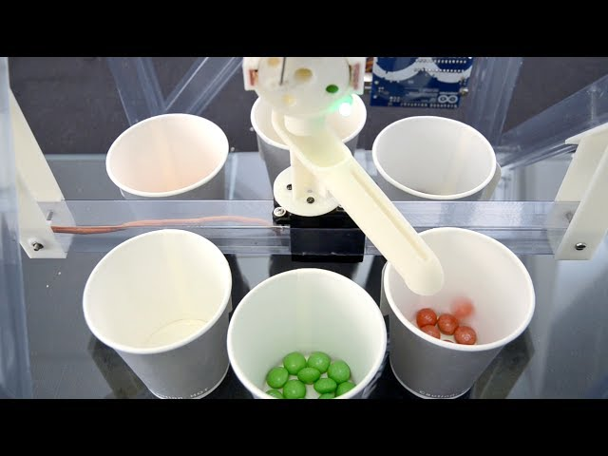
Notes:
Skittle color sorter

Slide 5
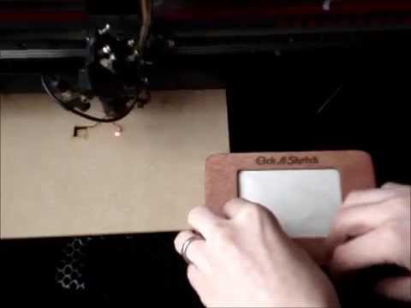

Slide 6
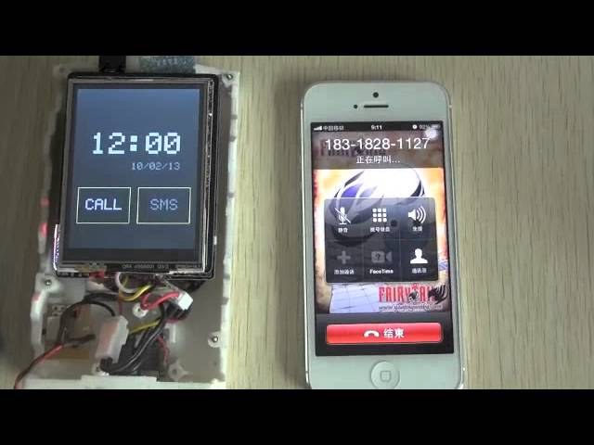

Slide 7
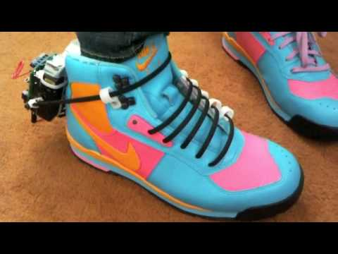

Slide 8


Slide 9
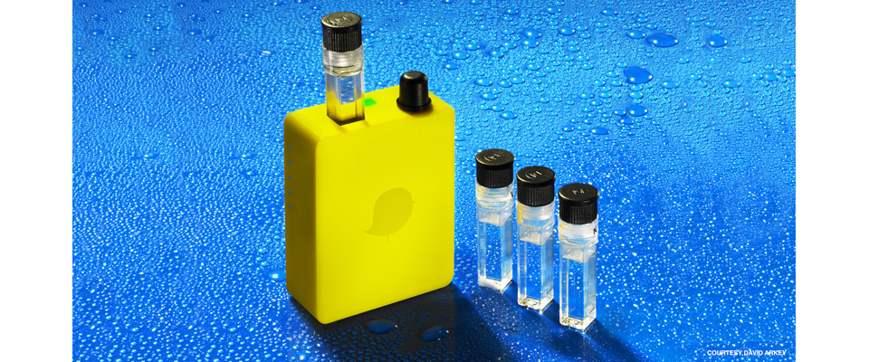

Slide 10


Slide 11
What is a Micro Controller
Small computer on a single integrated circuit containing a processor core, memory, and programmable input/output peripherals.
Microcontrollers are used in automatically controlled products and devices, such as automobile engine control systems, implantable medical devices, remote controls, office machines, appliances, power tools, toys and other embedded systems.

Slide 12
Types of Micro Controller
Atmel
Pic
Propeller Parallax
ARM

Slide 13
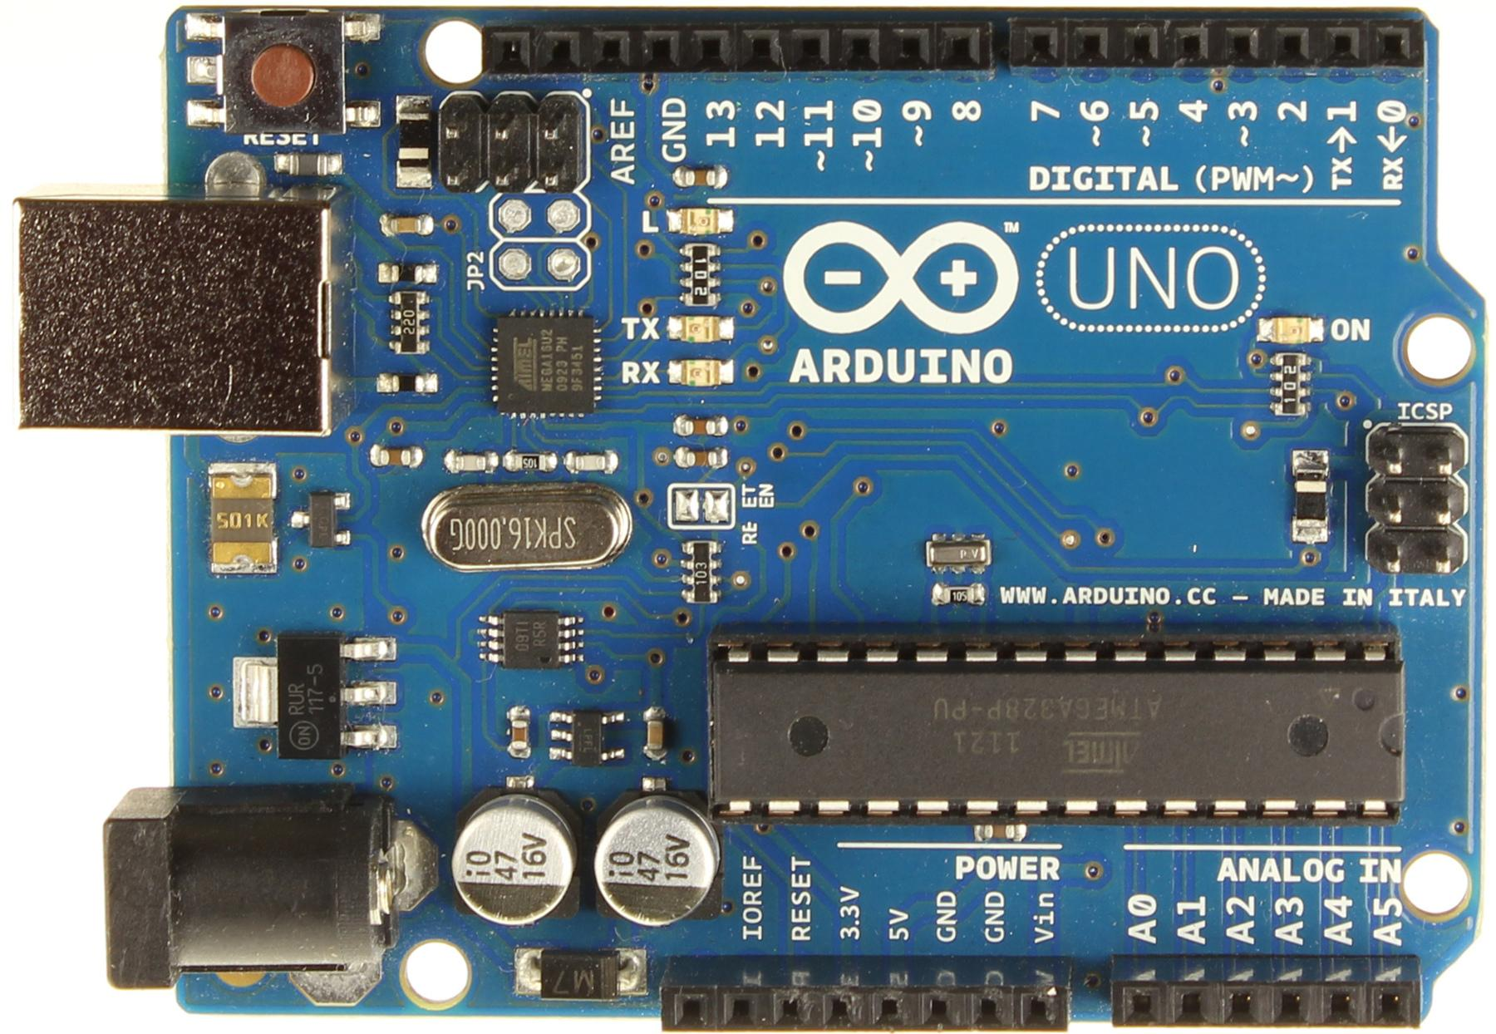
Atmel - Arduino

Slide 14
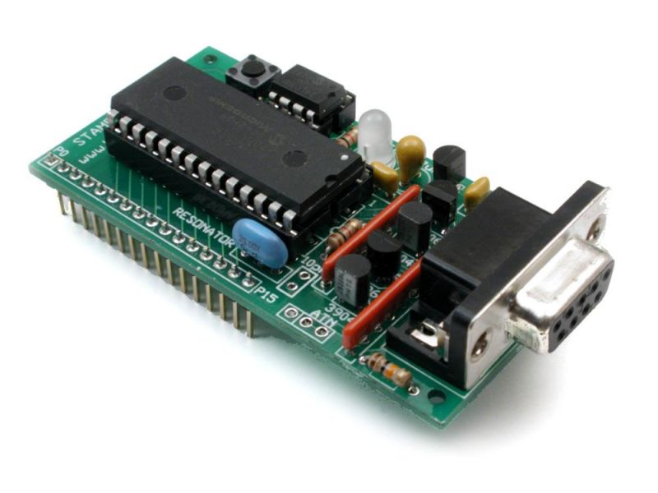
PIC

Slide 15
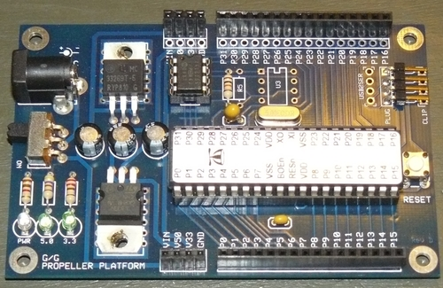
Propellor Parallax

Slide 16
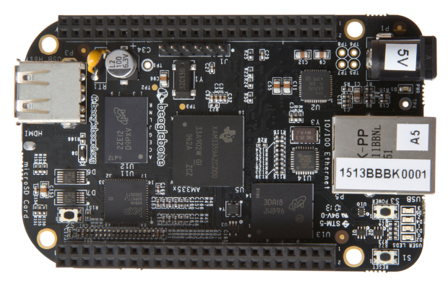
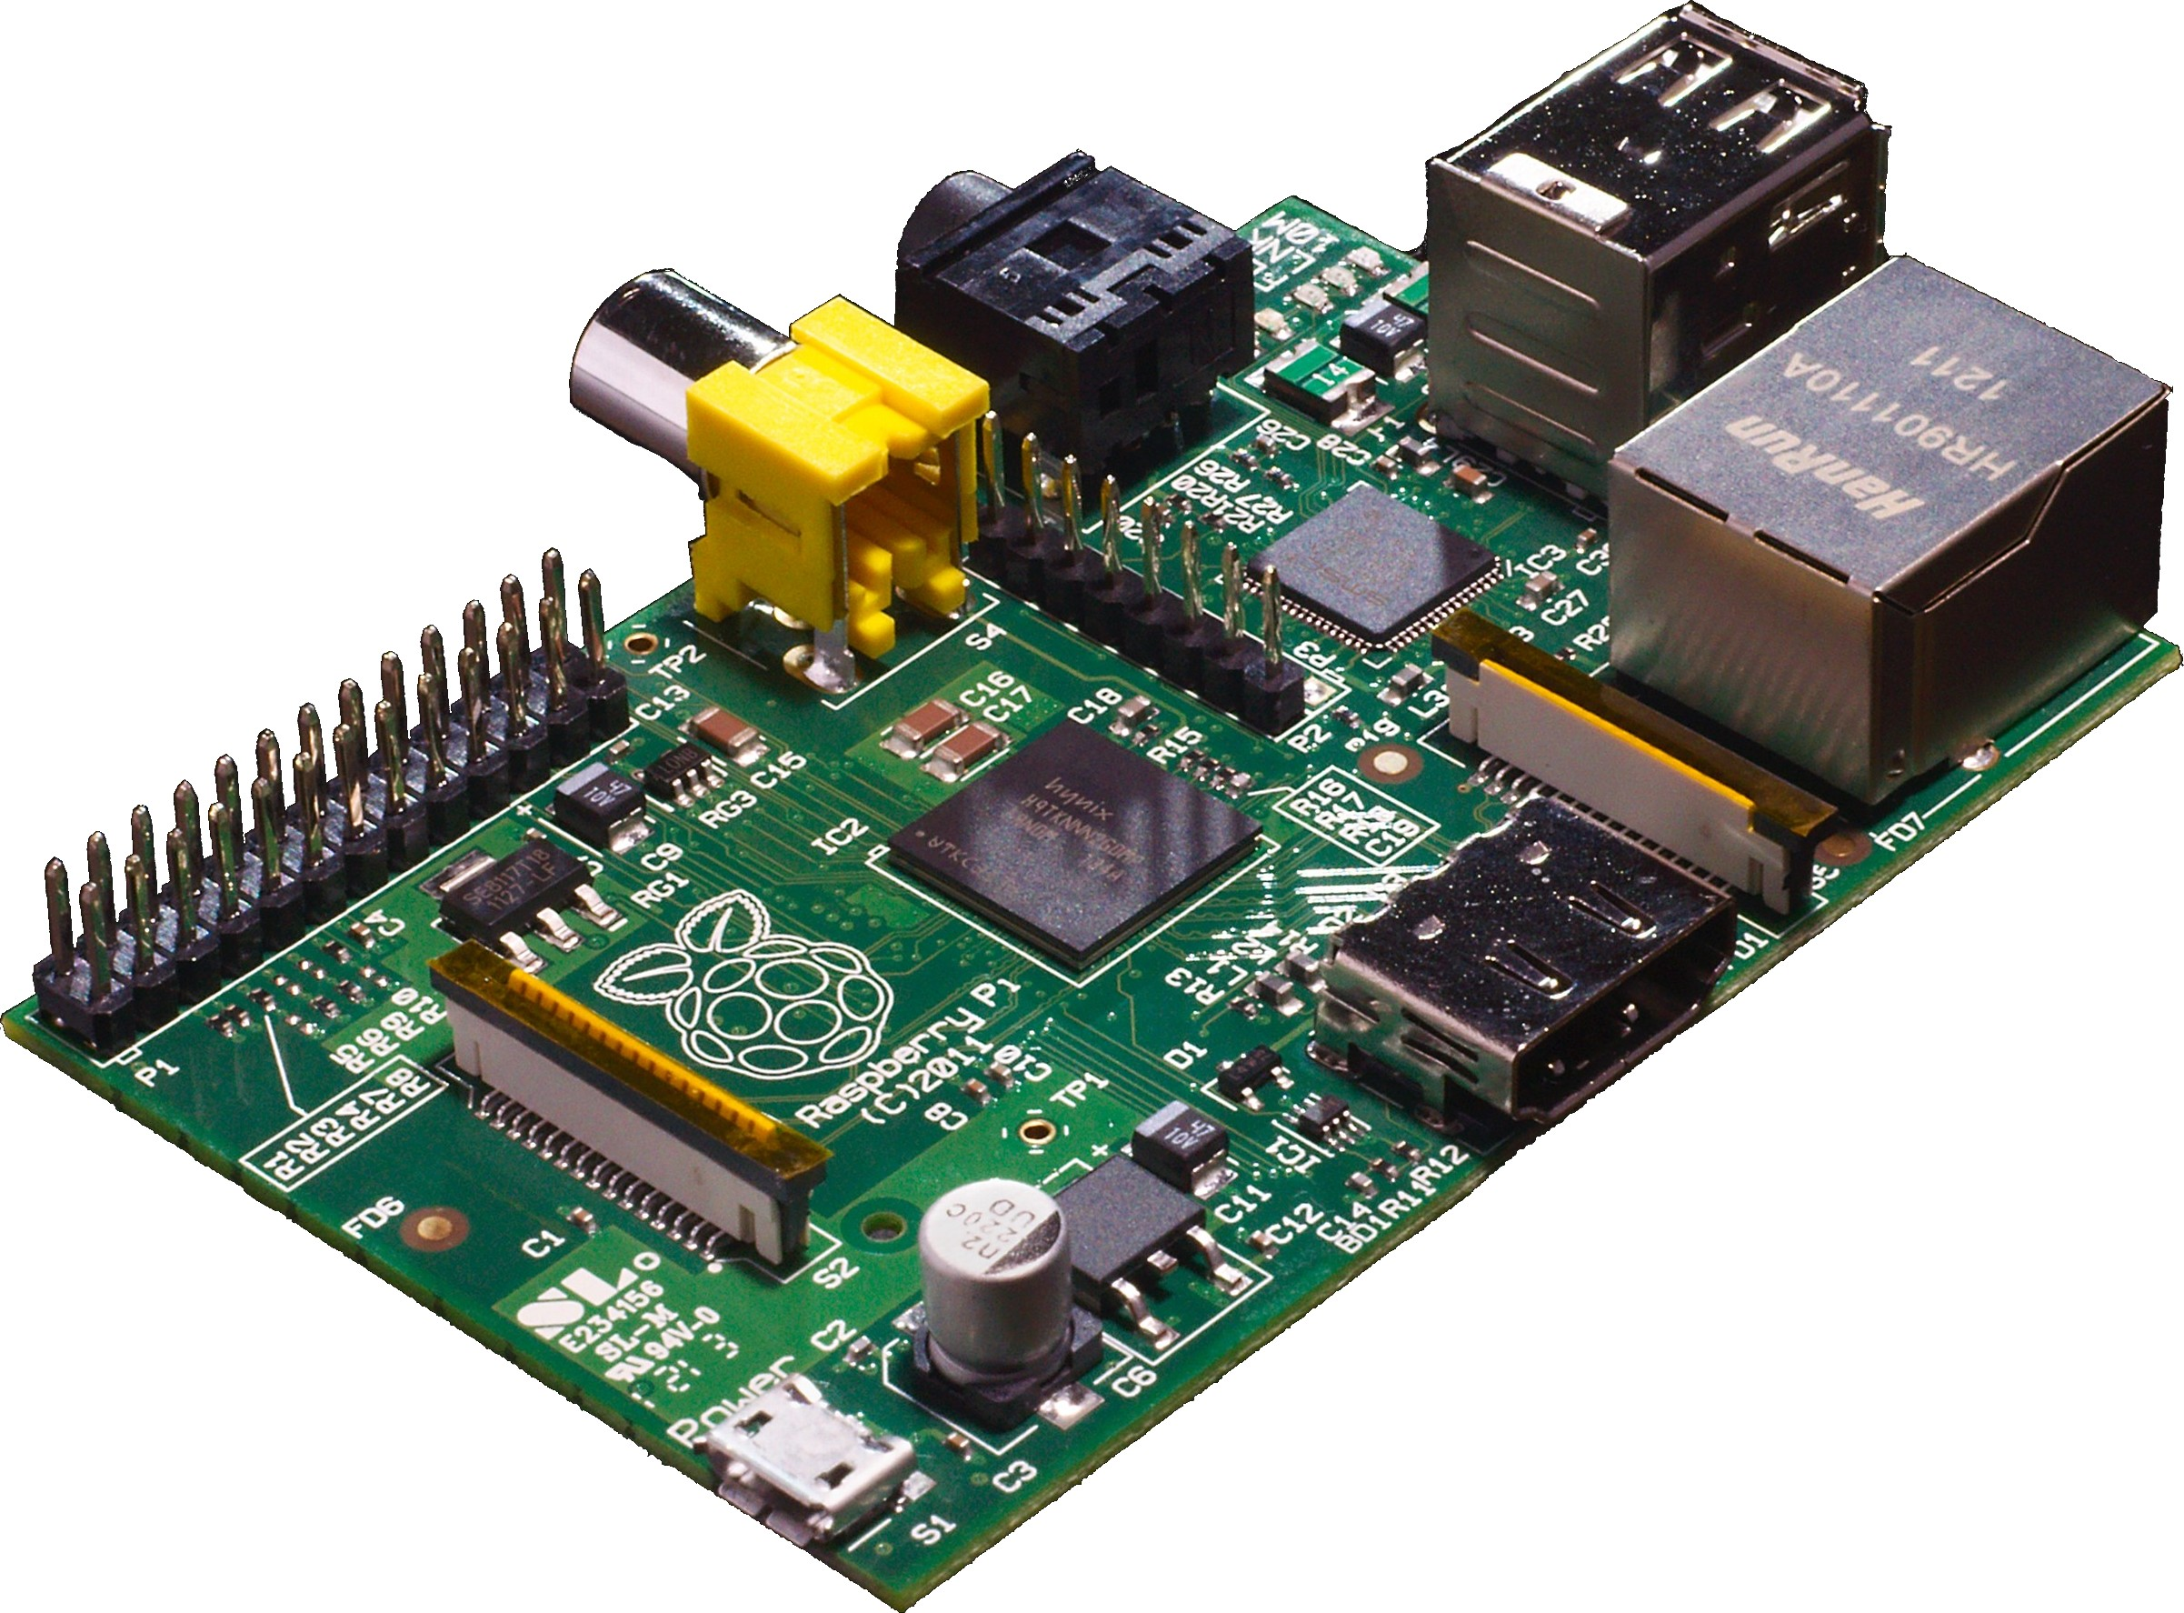
Arm - Beaglebone - Raspberry PI

Slide 17
Open Source - Software
Open source software is software that can be freely used, changed, and shared (in modified or unmodified form) by anyone. Open source software is made by many people, and distributed under licenses that comply with the Open Source Definition.
Notes:
Maker movement

Slide 18
Open Source - Hardware
The CERN–OHL is to hardware what the General Public Licence (GPL) is to software. It defines the conditions under which a licensee will be able to use or modify the licensed material. The concept of ‘open-source hardware’ or ‘open hardware’ is not yet as well known or widespread as the free software or open-source software concept. However, it shares the same principles: anyone should be able to see the source (the design documentation in case of hardware), study it, modify it and share it.
Notes:
Open hardware leads to the development of other devices

Slide 19
3D printing
3D printing or additive manufacturing is a process of making three dimensional solid objects from a digital file. The creation of a 3D printed object is achieved using additive processes. In an additive process an object is created by laying down successive layers of material until the entire object is created. Each of these layers can be seen as a thinly sliced horizontal cross-section of the eventual object.

Slide 20
3D printing - Types
Selective laser sintering (SLS)
Fused deposition modeling (FDM)
Stereolithography (SLA)

Slide 21
3D printing
http://3dprinting.com/wp-content/uploads/2012/06/Infographic-Sculpteo.jpg

Slide 22
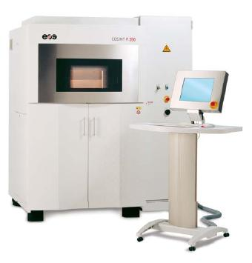
SLS

Slide 23
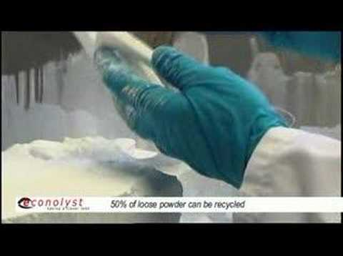
SLS

Slide 24
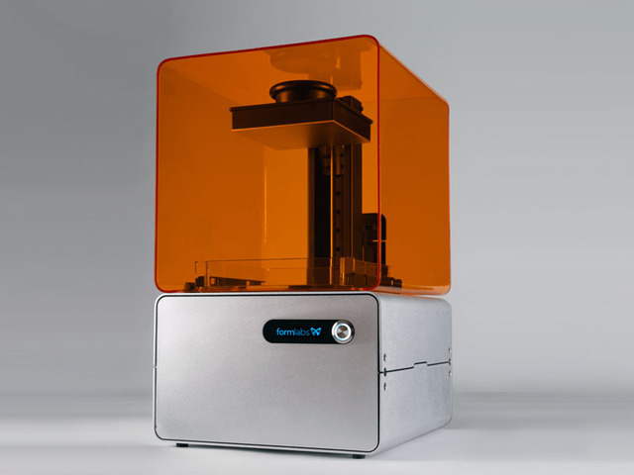
SLA

Slide 25
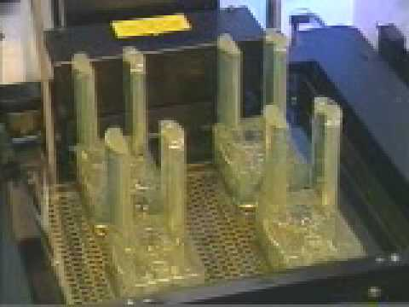
SLA

Slide 26
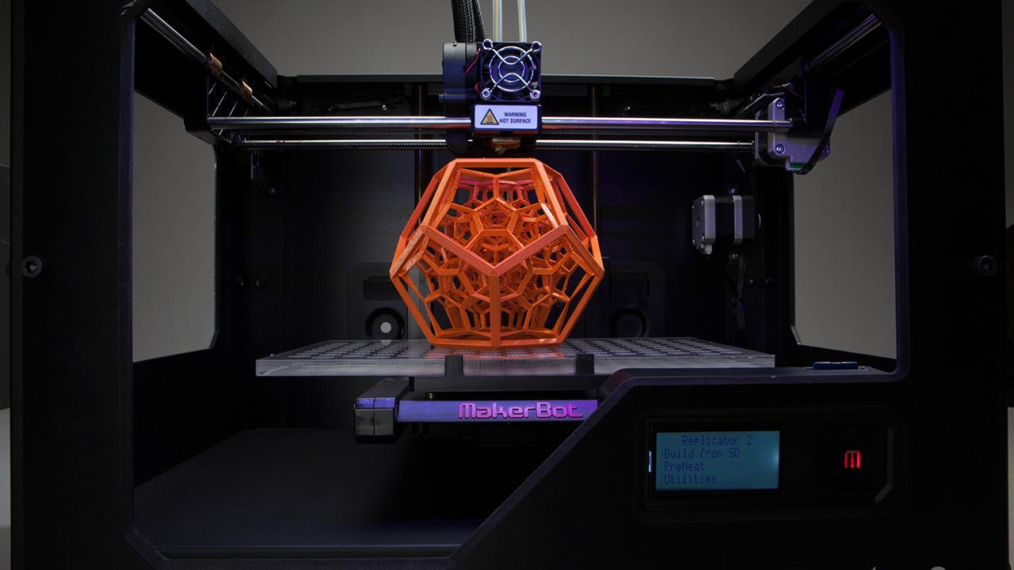
FDM

Slide 27
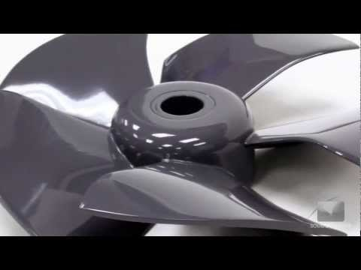
FDM

Slide 28
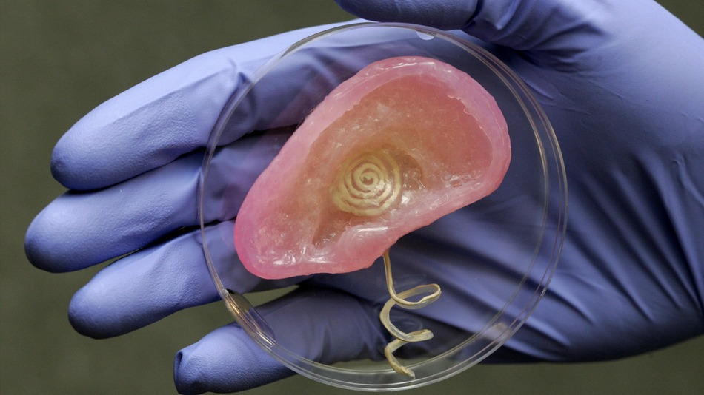

Slide 29
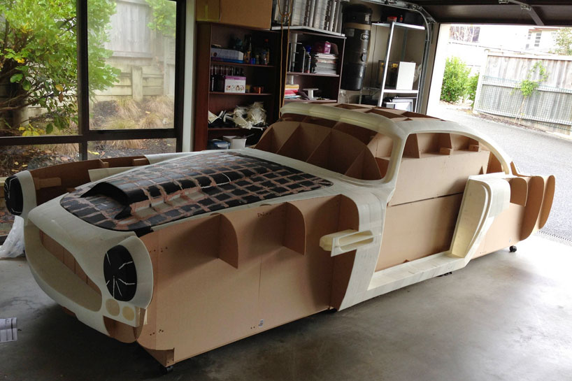

Slide 30
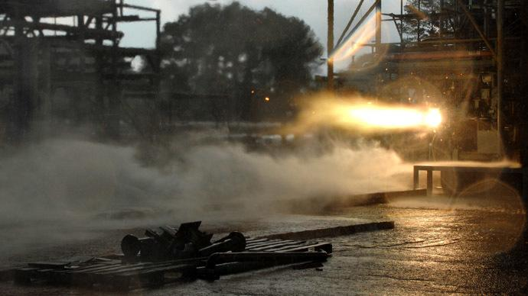

Slide 31
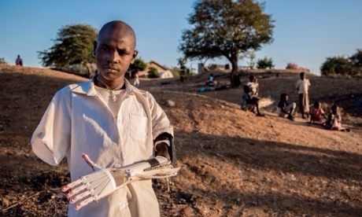

Slide 32
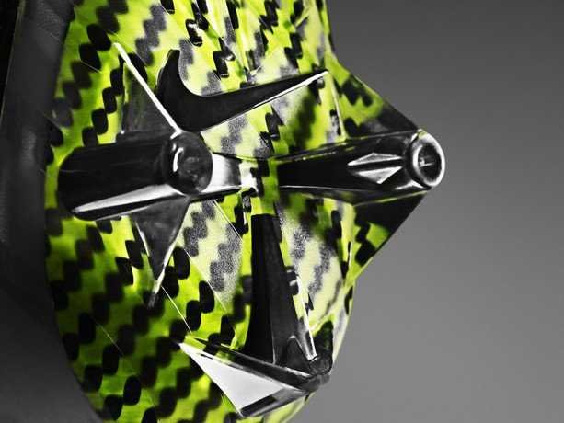

Slide 33
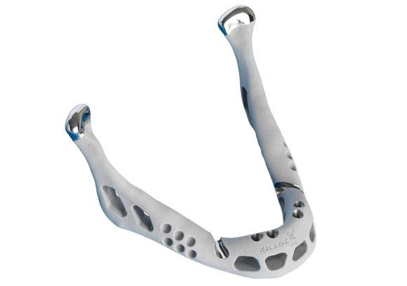

Slide 34
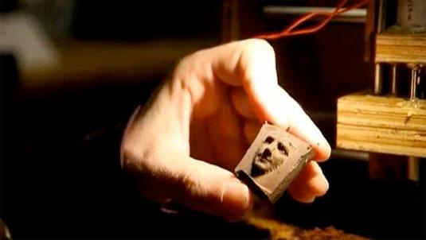

Slide 35
